Slide 1
Mass-suite: A novel Python package designed for mass spectrometry data analysis
Ximin Hu¹, Derek Mar⁴, Nozomi Suzuki⁴, Bowei Zhang⁴, David A. Beck³, Edward P. Kolodziej²
1. Civil and Environmental Engineering, University of Washington, Tacoma, WA, United States. 2. Sciences and Mathematics (UWT); Civil and Environmental Engineering (UWS), University of Washington (Tacoma/Seattle), Tacoma, WA, United States. 3. Chemical Engineering, University of Washington, Seattle, WA, United States. 4. Materials Science and Engineering, University of Washington, Seattle, WA, United States.

Slide 2
Introduction
Why
Mass-suite
-Full-stack capability
-Python is popular
-Different angle of view
High Resolution Mass Spectrometry
-Novel technology
-Huge data
-Limited tools available
Pollutant
in water
-Complicated in environment
-Challenge in identification & tracking
Notes:
Novel technology for water quality assessment
Data massive for interpretation and detailed analysis
Current software hard to meet every needs
Different angle of views: rather than single/few compound, analyze the sample using feature groups/clusters to assess it Macroscopically
Python – Kaggle survey showed 81% users choose Python as primary programming language for data science related project, 2019

Slide 3










Overview of Mass-suite
data processing
Other tools
Essential functions for HRMS data processing:
Mzml import
Peak picking & Alignment
Blank subtraction
Data curation
More..
HRMS data processing assisting tools:
Formula annotation
MS2 spectrum online search
HRMS data quality report
More..
visualization
Always new
Various plot tools for visualizing HRMS data:
Chromatograms
Spectrums
Static/Interactive options
More..
Data mining
There are always something new:
Source identification
Source quantitative apportionment
MS2 data mining
Even more..
Explore HRMS data with data science tools:
Principle Component Analysis
T-SNE Dimension reduction
Clustering analysis based on DBSCAN/OPTICS
Various modeling options
More..
Notes:
Four major modules of Mass suite
Data processing covers basic needs such as peak picking, alignment, blank subtraction
Visualization tool includes interactive interface such as TIC, chromatogram and spectrum, and statistical summaries of the samples
The datamining tool is the core strength of the package, provides user better vision of their data
There are also other tools in the package assisting analysis, including..
Aside of those, new functions are keep updating

Slide 4
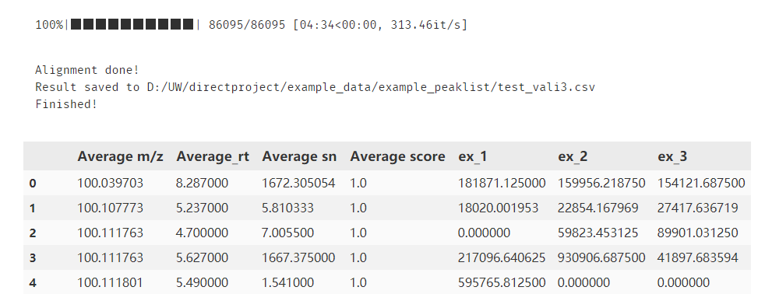
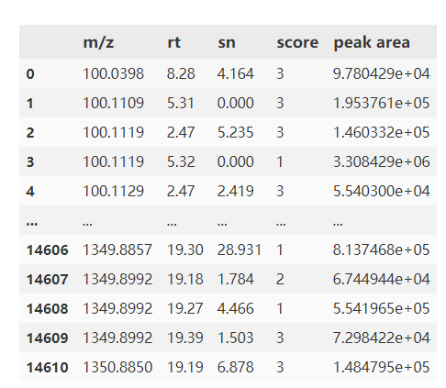
Example showcase
Feature extraction & alignment
One-line option
mss_process(mzml folder,
output filename=‘align.csv’,
*param)
*param defines:
Minimal scan
Intensity filter
Mass error tolerance
Retention time tolerance
Etc.
Step-by-step option
scans = get_scans(filepath, *param) #noise removal noise_removal(scans, threshold=3000) #Generate peak list peak_list(scans, *param)
* Score calculated from randomforest model, built on 5000 training dataset
Notes:
Showcase 1

Slide 5
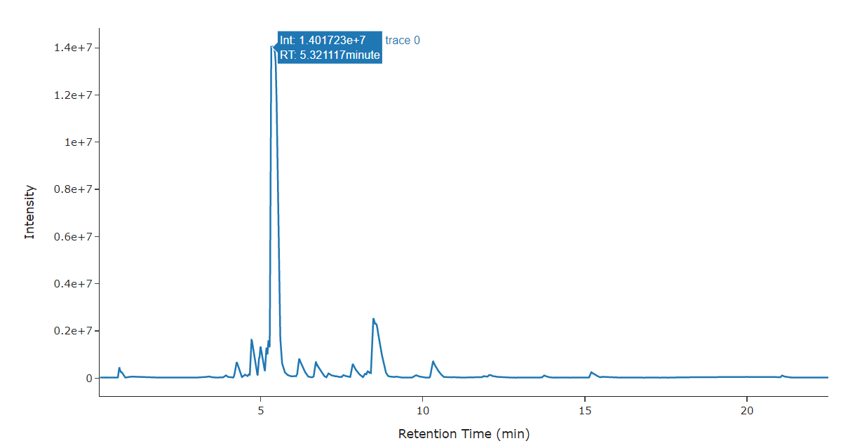
Example showcase
Data interactive interface
visreader.ms_chromatogram(mzmlfile,
formula/mass,
error tolerance=10,
search_online=True)
Other options:
TIC plot
MS spectrum (MS1 and MS2)
Isotopic plot
Peak Integration
Notes:
Showcase 2

Slide 6
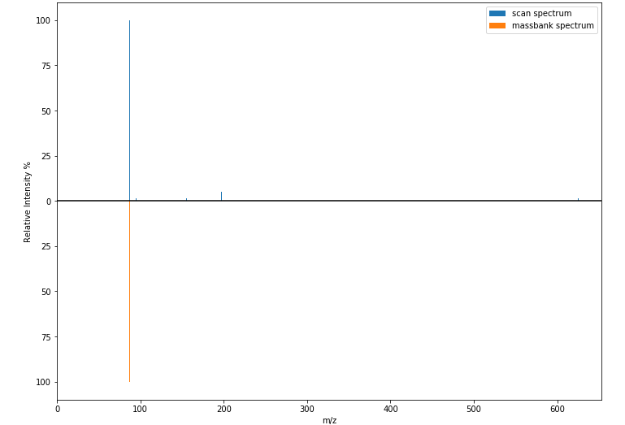
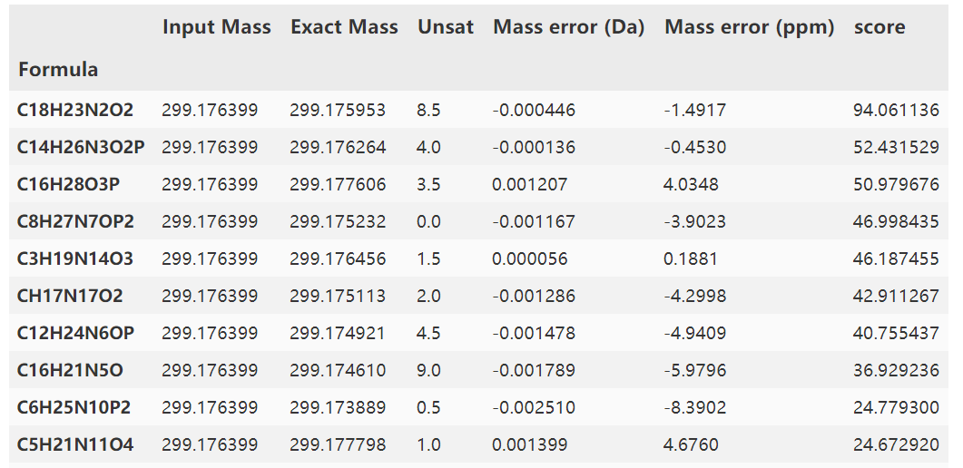
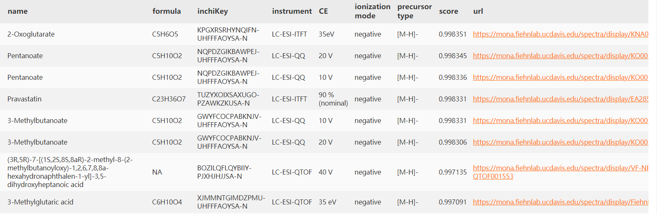
Formula annotation
Interactive plot for HRMS data visualization
Feature annotation
With online/in-house database
Notes:
Showcase 3

Slide 7
Reliability
Comparison between different platforms
Annotation with in-house standards
Notes:
As a new tool, the package needs to be reliable to users in order to produce robust results, thus two tests were conducted

Slide 8
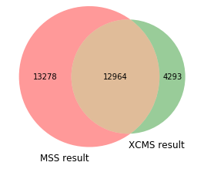
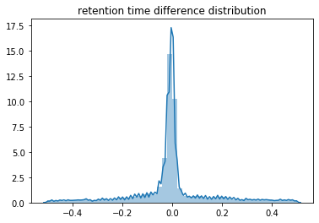
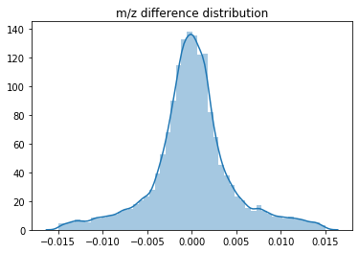
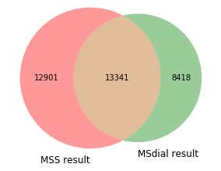
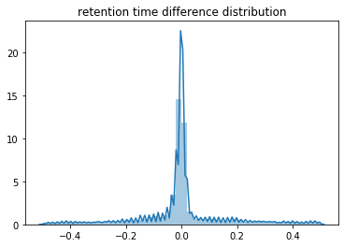
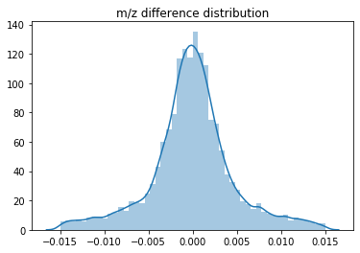
*Test done on the same sample (set of 3) with same parameter, XCMS processed on the web interface
Notes:
Venn diagram showed majorities of features were overlapped from Mass-suite and selected platform, the distribution plot suggests the rt/mz slicing is comparable

Slide 9

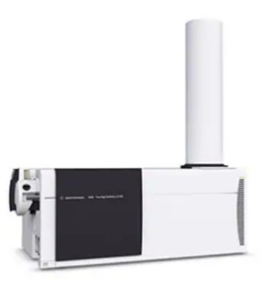

In house sample annotation
Samples with 413 known compound spiked were processed by Mass-suite
* Mismatch derives from bad peak shape and function parameter settings, only matched through MS1 chromatograms
Notes:
Using a known compound spiked sample processed through mass-suite, the result showed 99% of the compound peaks in the list were found.

Slide 10
Data mining
Statistical analysis
Clustering analysis
Quantitative analysis
Mass-suite provides tools for Non-target HRMS data mining

Slide 11
Statistical analysis
PCA/T-SNE
Hypothesis
testing
Volcano plot
Similarity comparison
Etc.
Basic statistical analysis based on built-in python functions:
Notes:
The statistical module provides essential analysis tools for common workflow

Slide 12
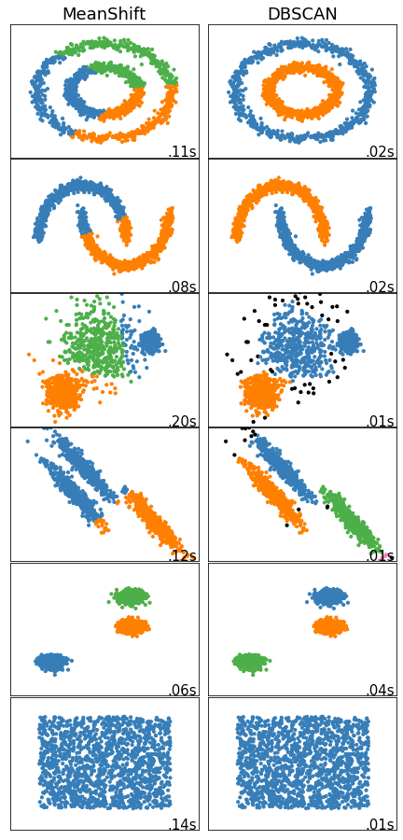
Clustering analysis
Based mainly on Density-based spatial clustering of applications with noise algorithm
Cluster the features with similar trend
No need for detailed comprehension
Suitable for various studies
OPTICS algorithm as alternative
Notes:
Clustering analysis provides a straight forward results of how the features look like when comparing to each others,
The algorithm aims at grouping the features that behaves similar while excluding the noises.
Advantage: showed as left, no need to know details for the data such as predefined cluster number, or data distribution; suitable for various studies such as time series, matrix effect assessment, or even spatial difference comparison

Slide 13
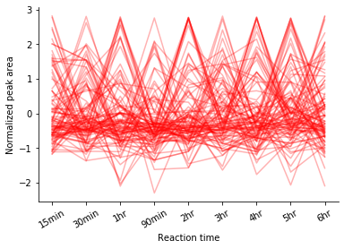
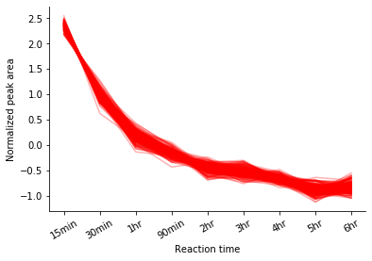
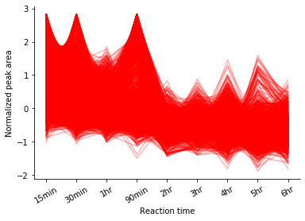
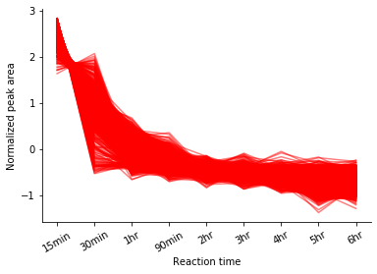
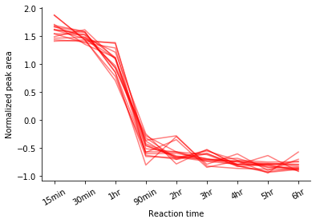
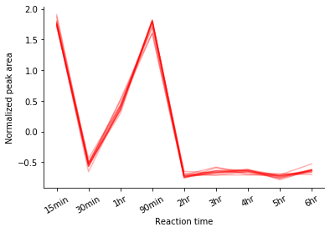
Distinguishing noise
Find similar features with error tolerance
Distinguish between different behaviors
* All data obtained from a time-series leaching experiment, normalization were conducted prior to clustering

Slide 14
Quantitative analysis
Watershed mixtures*
Modeling
Model options:
Linear regression
Lasso regression
Random Forest
SVM
…
Single chemical
Multiple clusters
Single cluster
Individual models
Ensemble method
Multivariate model
Single variate regression
100% highway runoff (SR520)
Coulter Creek in
→ 30% SR520
Kautz Creek in
→ 18% SR520
…
Field sample
→ ?% SR520
* Reference: Katherine T. Peter et al., Application of Nontarget High Resolution Mass Spectrometry Data to Quantitative Source Apportionment, Environmental Science & Technology 2019 53 (21), 12257-12268 DOI: 10.1021/acs.est.9b04481
Notes:
Using the sample on the left, combing with the clustering algorithm, here developed a modeling module in the package designated for the source quantitative analysis
There are flexible options, either using one chemical, multiple chemicals with similar behavior, or multiple groups chemicals with different trend, user can build their model and make prediction out of it

Slide 15
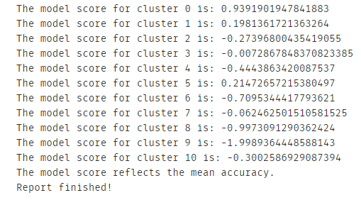
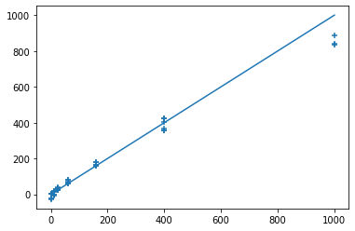
Modeling analysis
regression = feature_model(Data,
multiple_clusters=True,
model_method='ensemble_bagging_svc’,
report=True)
cluster_pred(regression,
Data,
sample_name=‘field1’,
selected_cluster=[0,1,3,5,7,9])
Predicted SR520 Vol. in 1000 mL sample (mL)
Actual SR520 Vol. in 1000 mL sample (mL)
Notes:
Showcase 4
Left showed if using multiple cluster, there will be an optional assessment score for the models
Right is an example fit from the built model, showing predicted values vs actual values

Slide 16
Functionality Comparison
Tool Features | Mass-suite | TidyMS | MZmine2 | XCMS | MS-DIAL
Language | Python | Python | Java | R | C#
Rawdata preprocessing | √ | √ | √ | √ | √
QC-based batch correction | × | √ | × | × | ×
Quality reports | √ | √ | √ | × | √
Normalization, imputation, scaling | √ | √ | √ | × | √
Feature annotation | √ | × | √ | × | √
Isotope grouping | × | × | √ | √ | √
Interactive visualization plots | √ | × | √ | × | √
Clustering statistical analysis | √ | × | × | × | ×
Modeling tools | √ | × | × | × | ×
* Functionality counted could be missing some features due to delay of software update
Reference: Riquelme G, Zabalegui N, Marchi P, Jones CM, Monge ME. A Python-Based Pipeline for Preprocessing LC-MS Data for Untargeted Metabolomics Workflows. Metabolites. 2020 Oct 16;10(10):416. doi: 10.3390/metabo10100416. PMID: 33081373; PMCID: PMC7602939.
Notes:
Here is a comparison chart, As mentioned at beginning ,mass-suite is designed towards full-stack capacity, and it built it’s novelty on the datamining tools especially the clustering analysis

Slide 17
Benchmarks
70%
Agreement on feature detection
As reliable as other platforms
99%
Accuracy of peak picking
With additional scoring based on RandomForest model
8 min/file*
Average processing time
Capable to be boosted up by supercomputers
4 Tools
Powering Non-target analysis
Based on data science approaches
30 Mb
Package size
Light for the installation and use
Open Source
Of the entire package
Keep updating, anyone can be involved
*Tested under default parameters as intensity cutoff = 3000, mz error = 10 ppm, alignment mz error = 10 ppm, rt error = 0.5 min, model_scoring was off, test were performed on personal laptop (Intel(R) Core(TM) i7-7700HQ CPU, 16GB RAM)
Notes:
Statistical tools, clustering tools, modeling tools and source identification tool (in dev)
Here are some benchmarks for the tool, As shown above, the tool is reliable, portable, and flexible

Slide 18
Development Roadmap
Testing
Dynamically update
Source identification
1
3
5
2
4
6
Annotation tool
GUI/web tool
Even more…
Notes:
Here is a roadmap for future development, will start from public beta test/debugging, finish up some tools such as annotation, identification and non-programmer friendly interface
The package will keep updating according to the feedback and needs

Slide 19

Related information
Installation:
https://pypi.org/project/mass-suite/
Github page & documentation:
https://github.com/XiminHu/mass-suite
Contact:
xhu66@uw.edu
Suggestions & Collaborations
are always welcome !

Slide 20
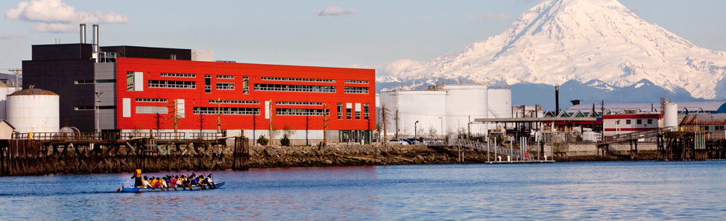

Acknowledgement:
A big shout to Professor Edward Kolodziej, Professor Dave Beck, Dr. Katherine Peter, and the Center of Urban Water for all their help during the development of this package.

Slide 21
References & dependencies
M Kösters et al; pymzML v2.0: introducing a highly compressed and seekable gzip format, Bioinformatics, doi: https://doi.org/10.1093/bioinformatics/bty046
Pedregosa et al., Scikit-learn: Machine Learning in Python, JMLR 12, pp. 2825-2830, 2011.
Martin Ester et al. 1996. A density-based algorithm for discovering clusters in large spatial databases with noise. In Proceedings of the Second International Conference on Knowledge Discovery and Data Mining (KDD'96). AAAI Press, 226–231.
Riquelme G et al. A Python-Based Pipeline for Preprocessing LC-MS Data for Untargeted Metabolomics Workflows. Metabolites. 2020 Oct 16;10(10):416. doi: 10.3390/metabo10100416. PMID: 33081373; PMCID: PMC7602939.
Tsugawa, Hiroshi et al. “MS-DIAL: data-independent MS/MS deconvolution for comprehensive metabolome analysis.” Nature methods vol. 12,6 (2015): 523-6. doi:10.1038/nmeth.3393
Horai, H. et al (2010), MassBank: a public repository for sharing mass spectral data for life sciences. J. Mass Spectrom., 45: 703-714. https://doi.org/10.1002/jms.1777
Katherine T. Peter et al., Application of Nontarget High Resolution Mass Spectrometry Data to Quantitative Source Apportionment, Environmental Science & Technology 2019 53 (21), 12257-12268 DOI: 10.1021/acs.est.9b04481
Mass-suite requires major dependencies:
Pandas 1.0.3 or higher
Numpy 1.16.5 or higher
Scikit-learn 0.23.0 or higher
Scipy 1.4.1 or higher
pymzml 2.4.6 or higher
PeakUtils 1.3.3 or higher
plotly 4.5.2 or higher
Optional dependencies for machine-learning:
Keras 2.3.1
Tensorflow 2.0.0
Pytorch 1.4.0 or higher

Slide 22

Thanks!

